Slide 1
Hire and Nurture Program
SQL Server Database training – Session 3
January 2021

Slide 2
Agenda
Normalization
Normal Forms with examples
T-SQL

Slide 3
Normalization
Why is a database normalized?
What are the types of normalization?
Why is database normalization important?
What is database denormalization?
Why would we De-Normalize a database?
Database normalization is the process of restructuring a relational database in accordance with a series of so-called normal forms in order to reduce data redundancy and improve data integrity. It was first proposed by Edgar F. Codd as an integral part of his relational model.
Drawbacks of data redundancy include:
Data maintenance becomes tedious – data deletion and data updates become problematic
It creates data inconsistencies
Insert, Update and Delete anomalies become frequent. An update anomaly, for example, means that the versions of the same record, duplicated in different places in the database, will all need to be updated to keep the record consistent
Redundant data inflates the size of a database and takes up an inordinate amount of space on disk
One of the driving forces behind database normalization is to streamline data by reducing redundant data. Redundancy of data means there are multiple copies of the same information spread over multiple locations in the same database.
First Normal Form (1 NF)
Second Normal Form (2 NF)
Third Normal Form (3 NF)

Slide 4
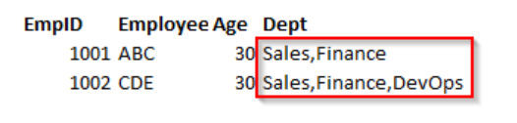
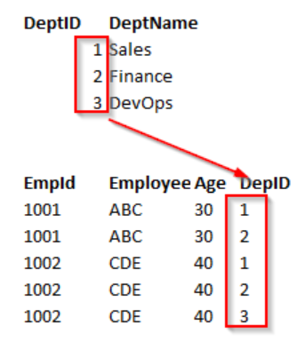
Normal Forms
First Normal Form (1NF) requires that a table satisfies the following conditions :
Rows are not ordered
Columns are not ordered
There is duplicated data
Row-and-column intersections always have a unique value
All columns are “regular” with no hidden values
In the following example, the first table clearly violates the 1 NF. It contains more than one value for the Dept column. So, what we might do then is go back to the original way and instead start adding new columns, so, Dept1, Dept2, and so on. This is what’s called a repeating group, and there should be no repeating groups. In order to bring this First Normal Form, split the table into the two tables. Let’s take the department data out of the table and put it in the dept table. This has the one-to-many relationship to the employee table.

Slide 5
Normal Forms
Second Normal Form and Third Normal Form are all about the relationship between the columns that are the keys and the other columns that aren’t the key columns.
Second Normal Form (2NF): An entity is in a second normal form if all its attributes depend on the whole primary key. So, this means that the values in the different columns have a dependency on the other columns.
The table must be already in 1 NF and all non-key columns of the tables must depend on the PRIMARY KEY
The partial dependencies are removed and placed in a separate table
Note: Second Normal Form (2 NF) is only ever a problem when we’re using a composite primary key. That is, a primary key made of two or more columns.
The following example, the relationship is established between the Employee and Department tables.

Slide 6
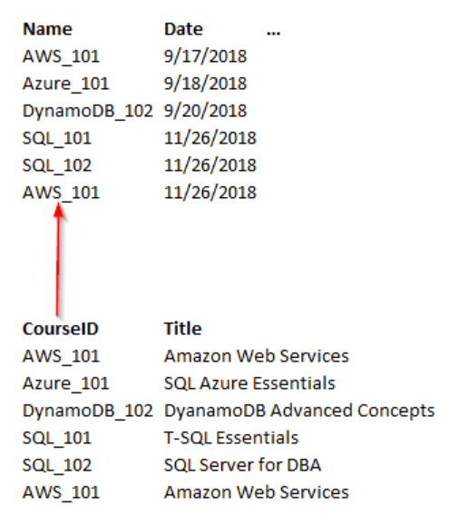
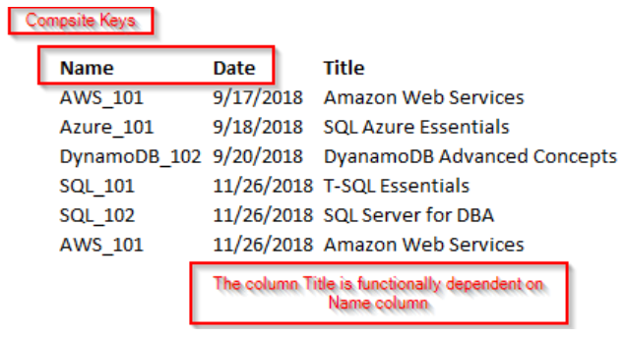
Normal Forms
In this example, the Title column is functionally dependent on Name and Date columns. These two keys form a composite key. In this case, it only depends on Name and partially dependent on the Date column. Let’s remove the course details and form a separate table. Now, the course details are based on the entire key. We are not going to use a composite key.

Slide 7
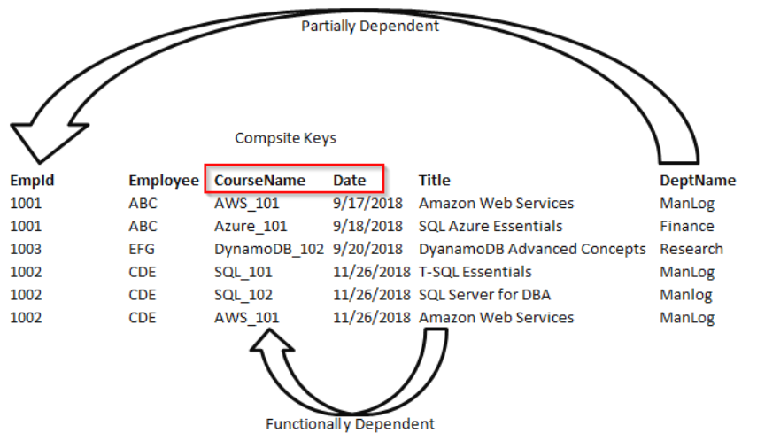
Normal Forms
Third Normal Form (3NF) states that we should eliminate fields in a table that do not depend on the key.
A Table is already in 2 NF
Non-Primary key columns shouldn’t depend on the other non-Primary key columns
There is no transitive functional dependency
Consider the following example, in the table employee; EmpID determines the department ID of an employee, department ID determines the department name. Therefore, the department name column indirectly dependent on the EmpID column. So, it satisfies the transitive dependency. So, this cannot be in third normal form.
In order to bring the table to 3 NF, we split the employee table into two.

Slide 8
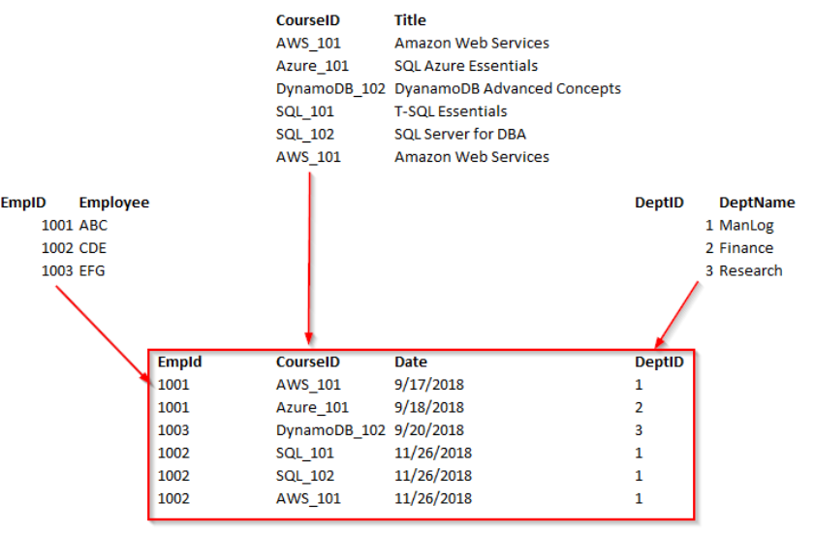
Normal Forms
Now, we can see the all-non-key columns are fully functionally dependent on the Primary key.
Although a fourth and fifth form does exist, most databases do not aspire to use those levels because they take extra work, and they don’t truly impact the database functionality and improve performance.

Slide 9
Denormalization
Denormalization is a strategy used on a previously-normalized database to increase performance
In computing, denormalization is the process of trying to improve the read performance of a database, at the expense of losing some write performance, by adding redundant copies of data or by grouping data.
Databases/tables must first be normalized to efficiently denormalize them
Database normalization is always a starting point for denormalization. Denormalization is a type of reverse engineering process that can apply to retrieve the data in the shortest time possible.
Let us consider an example; we’ve got an Employee table that in-house an email and a phone number columns. Well, what happens if we add another email address column, another phone number? We tend to break First Normal Form. It’s a repeating group. But in general, it is easy to have those columns created (Email_1, and Email_2 column), or having (home_phone and mobile_phone) columns, rather than having everything into multiple tables and having to follow relationships. The entire process is referred to as a denormalization.

Slide 10
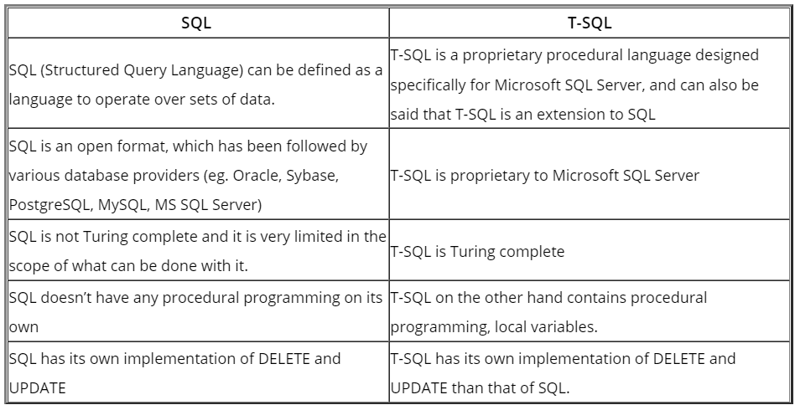
T-SQL
T-SQL is an extension owned by Sybase & Microsoft SQL Server. PL/SQL is an extension owned by Oracle whereas PL/pgSQL is an extension that is owned by PostgreSQL folks.
T-SQL features
Procedural programming
Local variables to provide more flexible control over the application flow.
Various support functions for processing strings, dates and logical/mathematical functions. This helps T-SQL comply with the Turing completeness test (a test that determines the universality of any given computing language).
Provides a specific implementation to DELETE and UPDATE than that of SQL as it allows FROM clause to be added. Once this is added, we will be able to use or include JOINs.
Provides a way to use BULK INSERT to import lots of data into a database table or a view in a specified user format.
T-SQL also allows you to have a greater grip on the programmability. An example of this is the use of stored procedures where you can alter the input parameters to have a changed output parameter as well.
An individual can create the required T-SQL units such as any other SQL scripts, Triggers, Functions or Stored procedures etc. to cater to specific requirements.

Slide 12
Advantages Normalization and T-SQL
Advantages of Normalization and T-SQL
There are numerous advantages that are available for us to discuss here, and we will just do that. Let us take a closer look at the advantages that Normalization provides us:
Normalizing a database to the lowest possible level gives us a greater overall database organization
It also ensures that there is no redundant data available
It also ensures that there is data consistency within the database itself
It also provides a better grip over database security as well.
Functional dependencies are very important and handled better during the normalization process itself.
Provides ways and means for flexible database design.
Normalization also ensures that there are smaller tables with smaller rows ensuring more rows per page (less logical I/O).
Index searching gets quicker as the indexes tend to be narrower and shorter.
Advantages of T-SQL:
T-SQL provides us ways and means to interact with SQL Server in a better way with SQL queries
Stored procedures bring in the concept of doing multiple things under a single transaction context
Triggers help in getting audit related stuff handled in a much efficient manner
There are more and more database related artifacts that we can handle at the database level itself, rather than relying on gaining these features via other programming languages for SQL Server.
The main advantage of T-SQL is that it provides better control over the database instance from the database instance level itself.

